Slide 1
Real-time Anomaly Detection in Video Surveillance
Feng Zheng, Bao Ngo

Slide 2
Our Problem
Nowadays, the number of surveillance cameras in the United States has been steadily increasing over the years because of technological advancements and security concerns both in public spaces and private environments.
Monitoring feeds and detecting anomalies in video surveillance systems frequently involves human operators. However, humans can be prone to fatigue, distraction, and neglect.
Developing real-time automatic anomaly detection in video surveillance can address this problem and offer a proactive response to shootings and other types of crime such as shoplifting, assault, and robbery because it can keep watching non-stop throughout the day and night, providing a prompt response to any odd activity.
Such a system could also serve as an early threat detection, which makes it possible to spot unusual or unexpected events as they take place. This can involve people loitering in sensitive areas, vehicles moving in peculiar patterns, or intruders breaking into secured facilities. By quickly identifying anomalies, security guards and police can respond quickly to possible threats reducing the chance of danger or damage.

Slide 3
Data Collection
For this project, we will utilize the UCF-Crime Dataset available at:
https://www.dropbox.com/sh/75v5ehq4cdg5g5g/AABvnJSwZI7zXb8_myBA0CLHa?dl=0
The UCF-Crime Dataset contains a collection of surveillance videos capturing various crimes such as fighting, road accidents, robbery, etc., and normal activities. Each video clip is labeled with information about the type of anomalous event or normal, providing a suitable foundation for training and evaluating our real-time anomaly detection system.

Slide 4
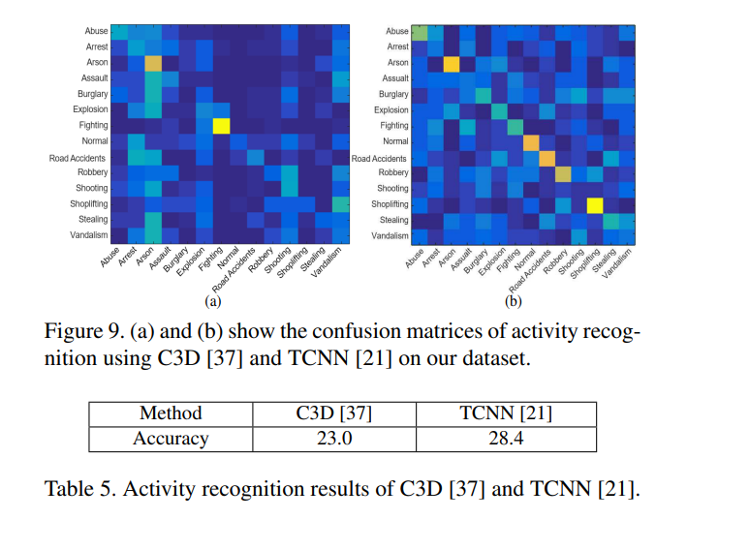
Preliminary Analysis
To help us recognize normal and anomaly and each of the 13 anomalous activities, we plan to use the pre-trained I3D or C3D classification model.
During the process of doing this project, we found a related project conducted at UCF. They used C3D to detect normal and abnormal activities and got a very good result. However, their accuracy is very low (around 23%) when they use C3D to detect the crimes.
We plan to use I3D model and compare the performance of our model and their model.

Slide 5
Methodologies
I3D
Video Explain Model

Slide 6
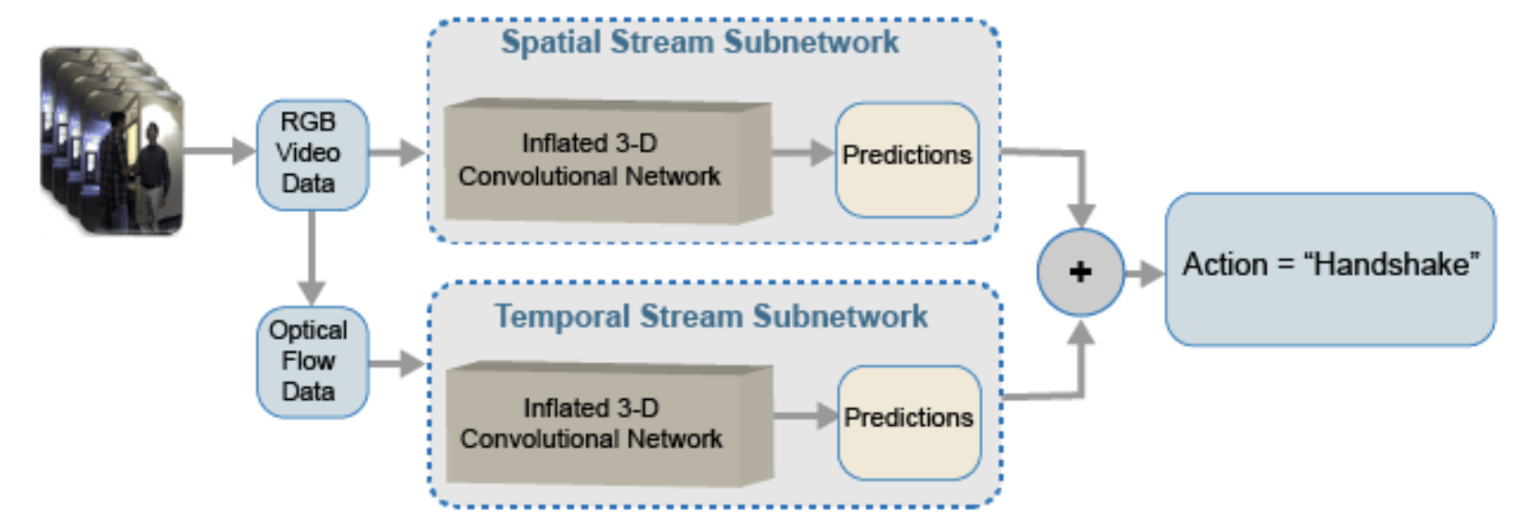
I3D
A convolutional neural network model for video classification trained on the Kinetics dataset.

Slide 7
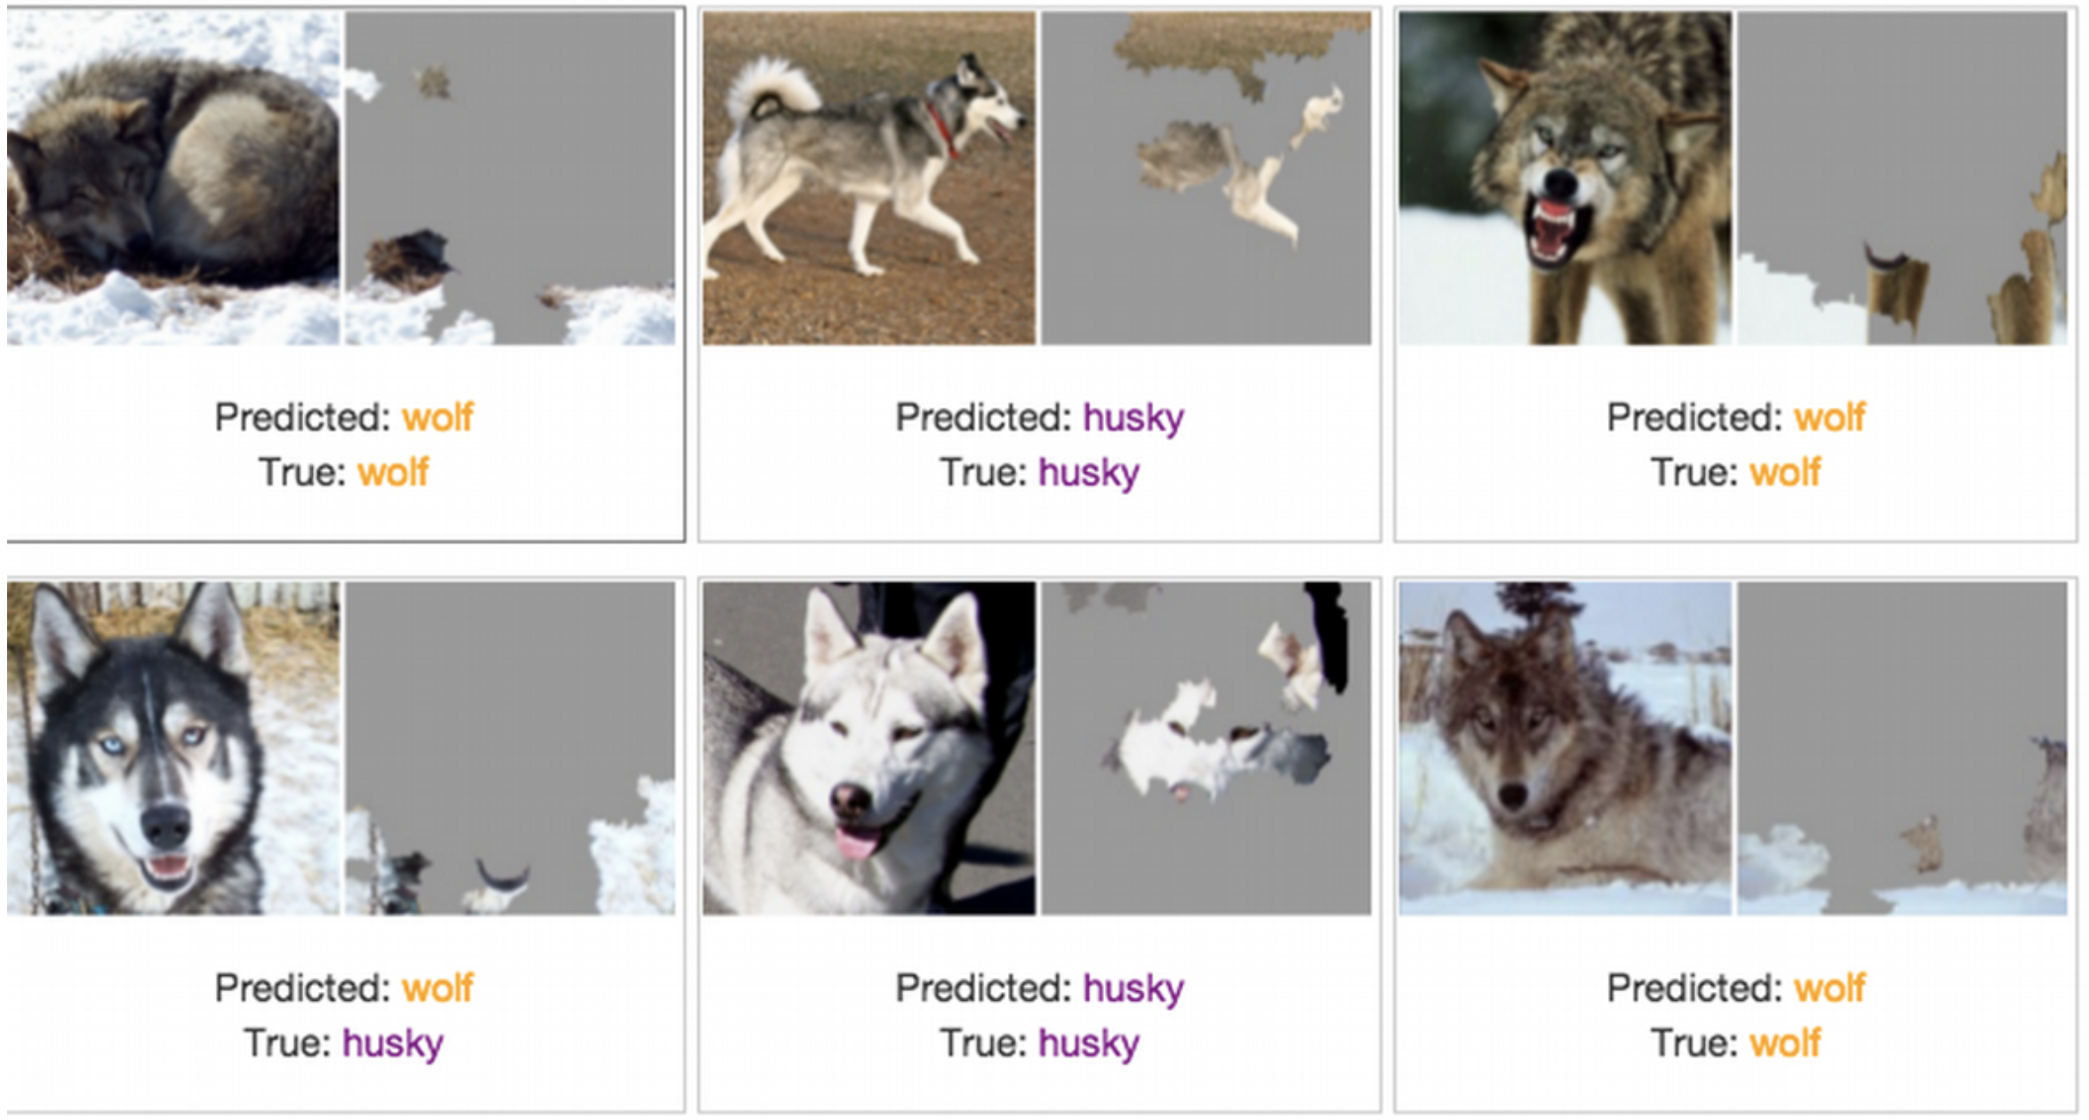
Video Explainity Method
Use LIME, sharp, or CLAD to explain why the prediction is made

Slide 8
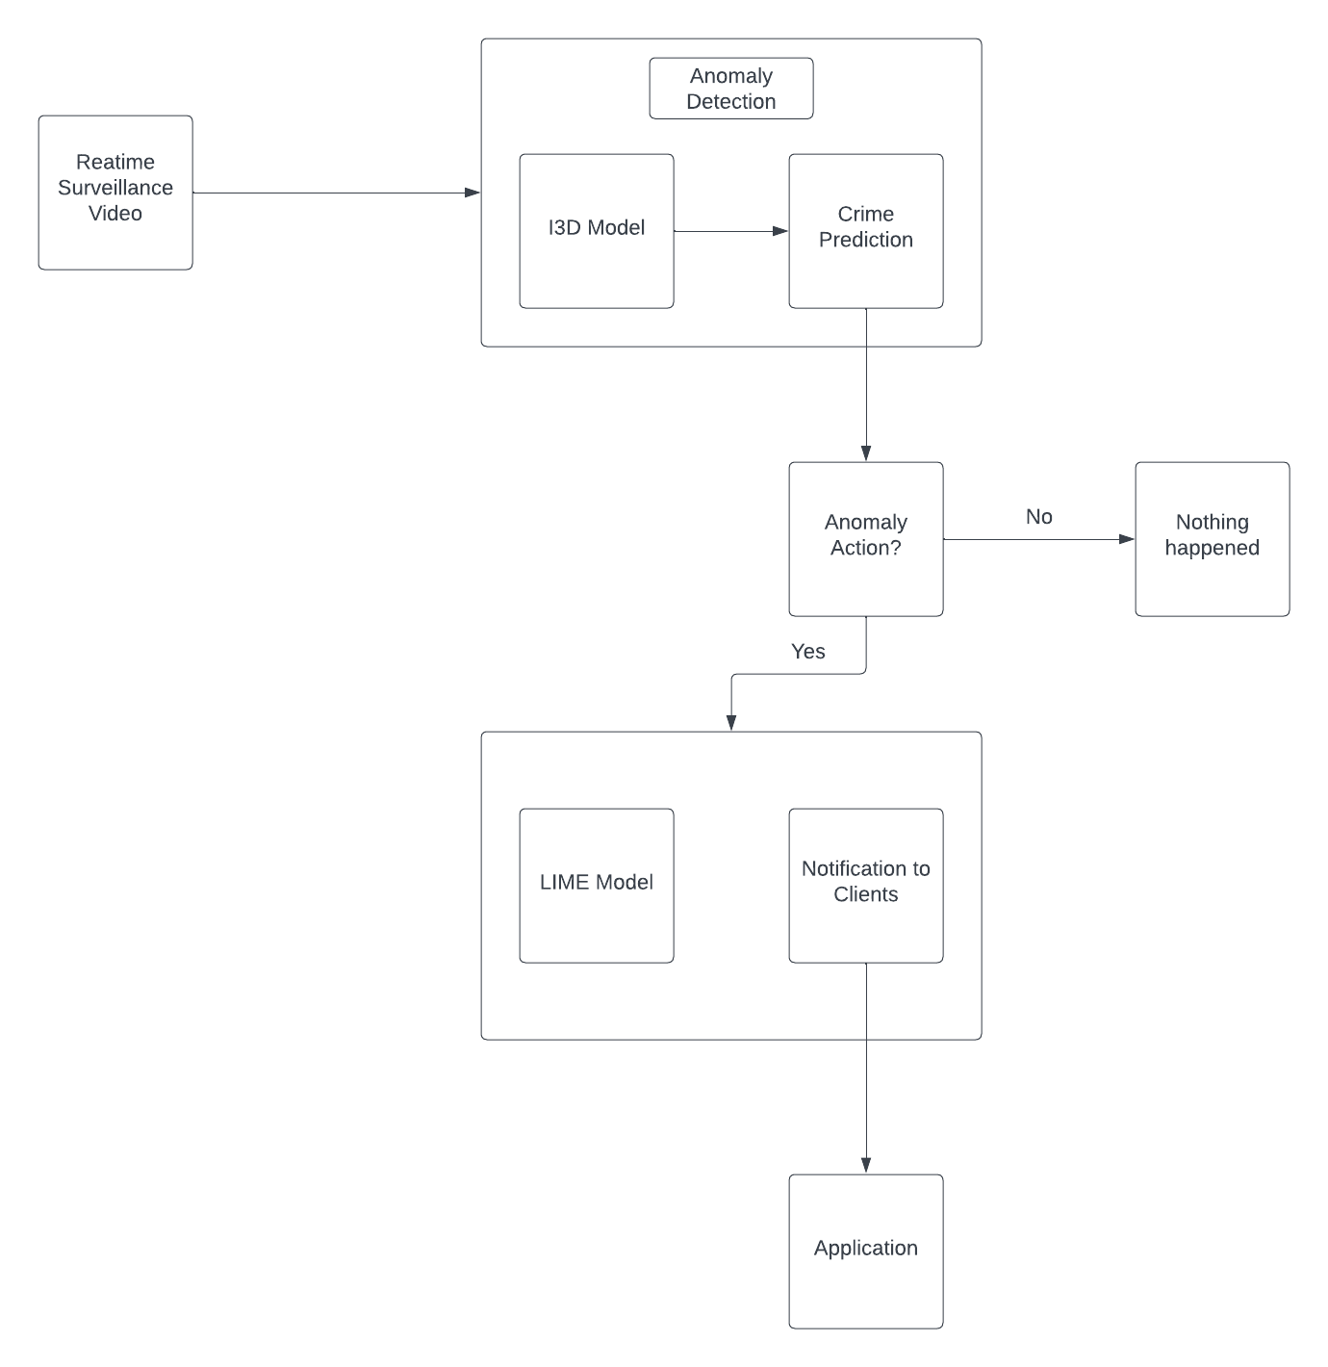
Roadmap

Slide 9


